Slide 1
Existing user account – full verified data
TPP+ Screencast

Slide 2
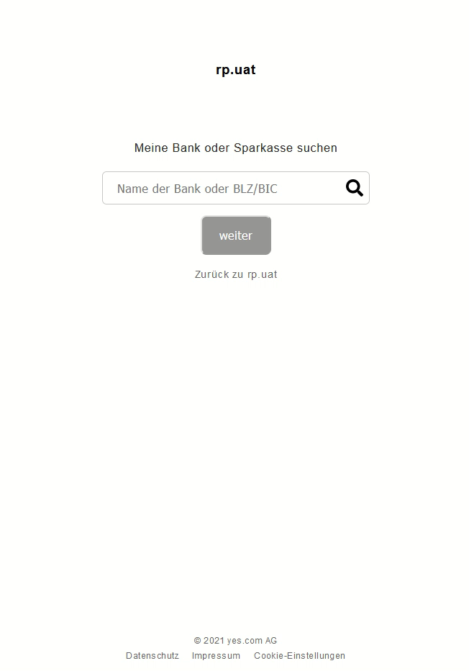
Existing user account – full verified data

Slide 3
CRIF GmbH • Ndl. Hamburg • Friesenweg 4, Haus 13 • 22763 Hamburg
www.crif.de

